Slide 1
FS 5, Polder 35/3
Flap gate is closed.
Lift gate is open
Nuts and bolts of baseplate of lift gate are missing.

Slide 2
Overview

Slide 3
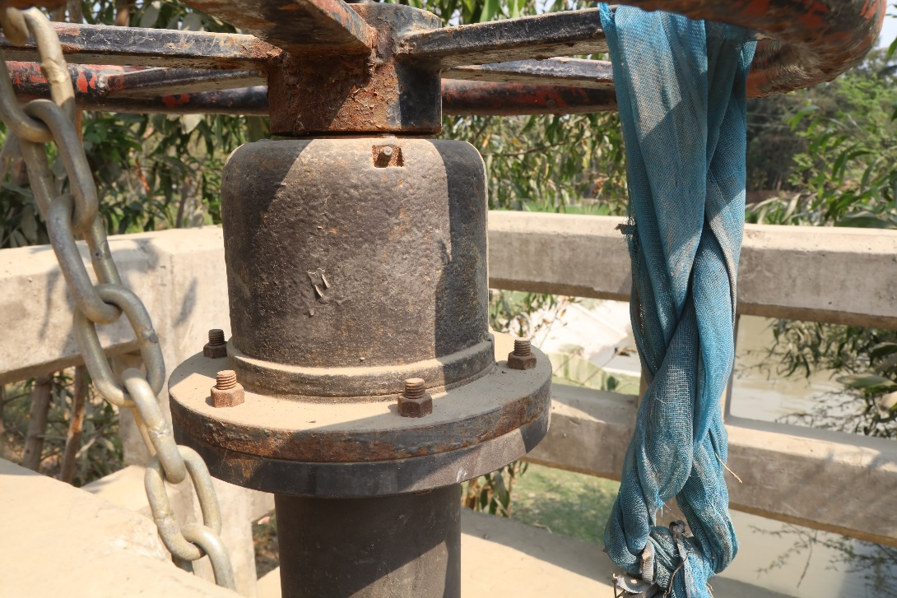
Country Side Lift Gate

Slide 4
Country Side Slope Protection

Slide 5
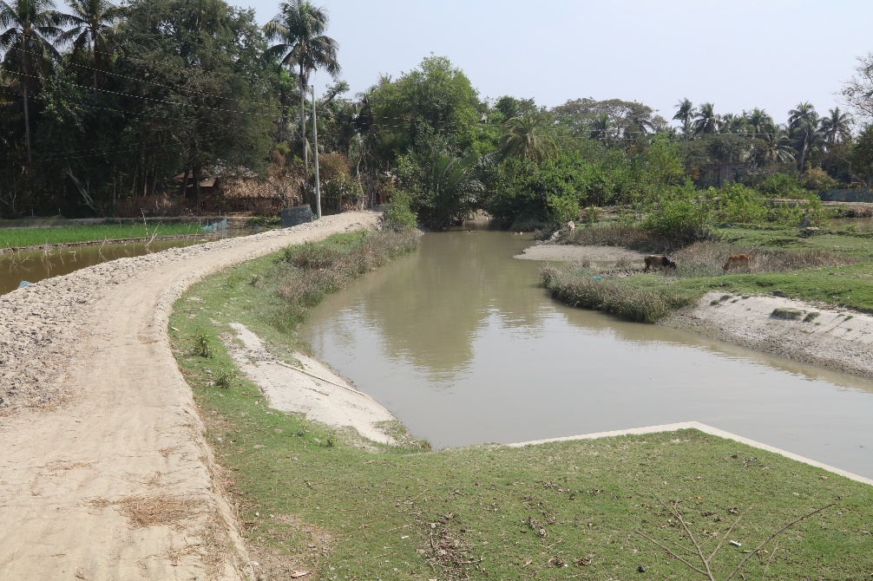
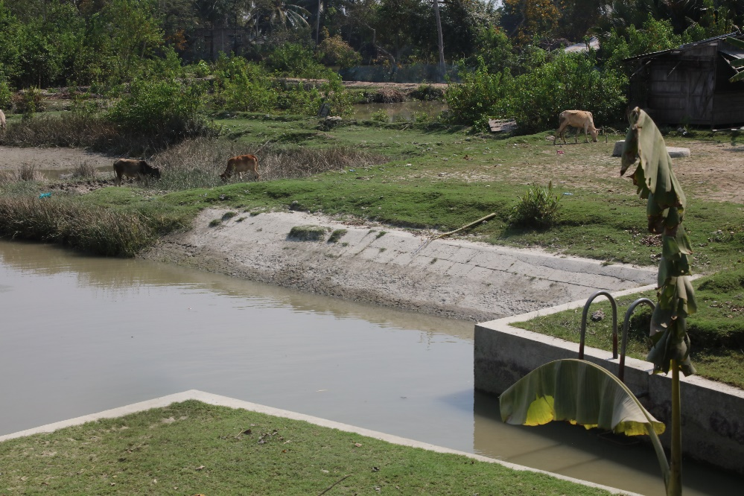

Slide 6
Riverside Flap Gate

Slide 7
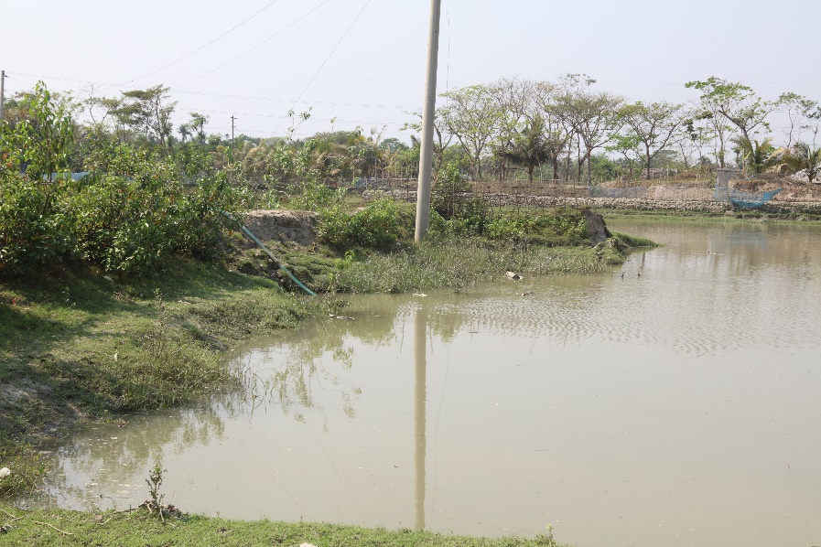
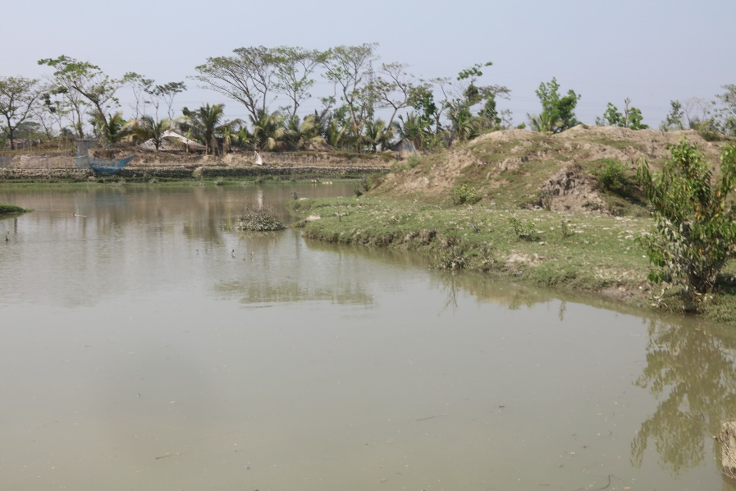

Slide 8
Water Level Gauge

